Slide 1

Sports Analytics Final Project
Steven Ruzzin - MIS665

Slide 2
Introduction
Purpose
Data
Information
Cleaning
Transformation
Model
Selection
Performance
Conclusions

Slide 3
Purpose
To determine, based on a sample survey of season ticket holders, who is likely not to renew their season tickets the next year, and what factors most contribute to that outcome.

Slide 4
Survey Data
9216 Respondents
19 Columns/Attributes
FAKEID, Y2Defect, Y1G5, Y1G4, Y1G3, Y1G2, Y1G1, Y1Price, YEARS, BACKER, AGE, INCOME, CHILD, GNDR, OWNHOME, SPORT, COMP, PCTMARR, HOMEVAL

Slide 5
Data Cleaning
Replacing blank values with null values
Removed CHILD, COMP, GNDR attribute,
Replaced null values in SPORT with 0
Used Average income from null income values
Dropped the null values

Slide 6
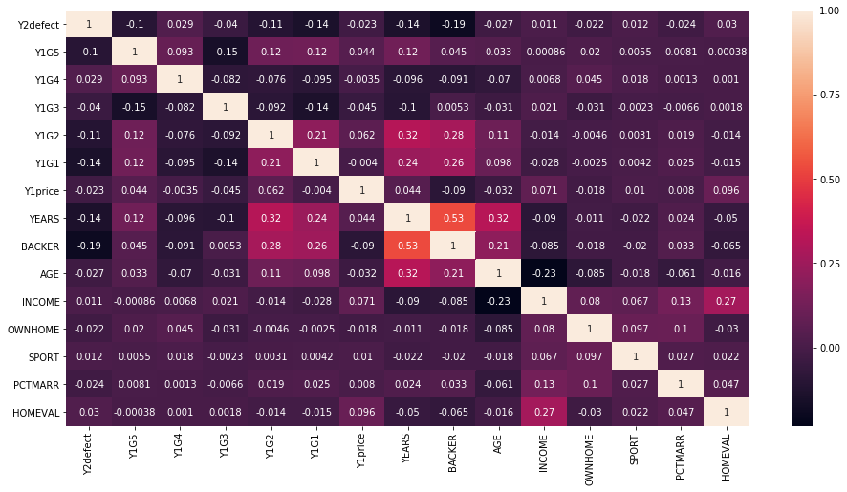
Correlation
Ran Correlation Analysis (right) to see how the data interacts.
Few strong correlations

Slide 7
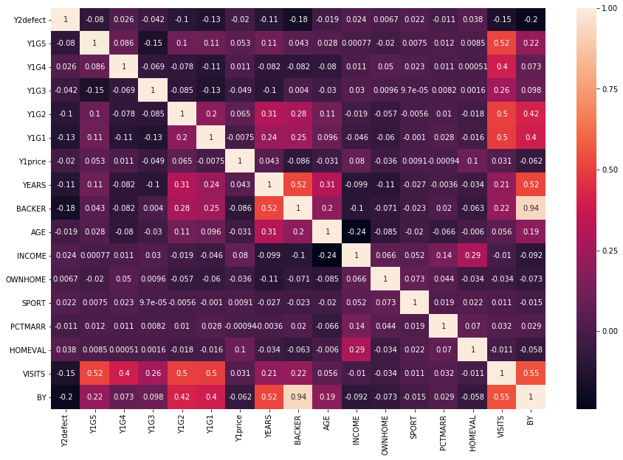
Transforming Data
After Correlation, grouped Games together in new “VISITS” attribute
Grouped VISITS together with BACKER attribute under “BY” attribute
Several other groupings tested that were not kept

Slide 8
Modeled Data
Logistic Regression
Initial Decision Tree (57%)
Regression Model (AUC 58%)
Adjusted Decision Tree (59%)

Slide 9
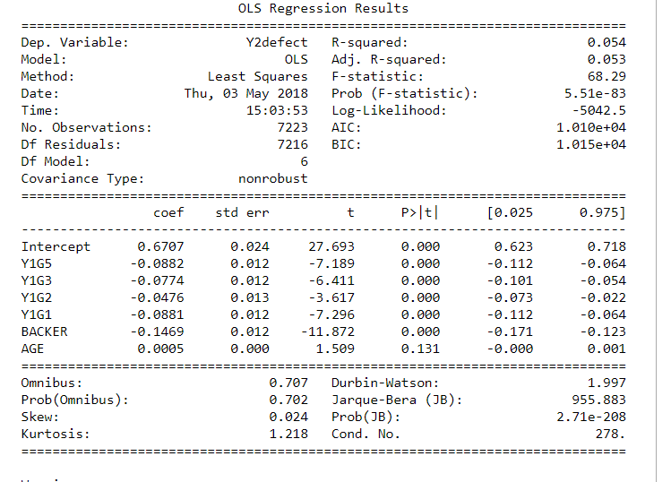
Conclusions
What we are trying to find
Significance

Slide 10
Conclusions
Suggestions
Limitations

Slide 11
Thank You

